Slide 1
The laboratory work 11
Developing android video game part 2

Slide 2
Starting the main activity
We need to hold the start screen for a few seconds and then switch to the main window. The code is written in SplashActivity class.
public class SplashActivity extends AppCompatActivity { @Override protected void onCreate(Bundle savedInstanceState) { super.onCreate(savedInstanceState); setContentView(R.layout.activity_splash); Thread thread = new Thread(){ @Override public void run() { try{ sleep(5000); } catch (Exception e) { e.printStackTrace(); } finally { Intent mainIntent = new Intent(SplashActivity.this, MainActivity.class); startActivity(mainIntent); } } }; thread.start(); } }

Slide 3
Flying fish
Creating the class FlyingFish
package com.example.thefishgame; import android.content.Context; import android.graphics.Bitmap; import android.graphics.BitmapFactory; import android.graphics.Canvas; import android.view.View; public class flyingFishView extends View { private Bitmap fish; public flyingFishView(Context context) { super(context); fish = BitmapFactory.decodeResource(getResources(), R.drawable.fish1); } @Override protected void onDraw(Canvas canvas) { super.onDraw(canvas); canvas.drawBitmap(fish, 0, 0, null); } }

Slide 4
Changing main activity
public class MainActivity extends AppCompatActivity { private flyingFishView gameView; @Override protected void onCreate(Bundle savedInstanceState) { super.onCreate(savedInstanceState); gameView = new flyingFishView(this); setContentView(gameView); } }

Slide 5
Changing the flying fish class
public class flyingFishView extends View { private Bitmap fish; private Bitmap backgroundImage; private Paint scorePaint = new Paint(); private Bitmap life[] = new Bitmap[2]; public flyingFishView(Context context) { super(context); fish = BitmapFactory.decodeResource(getResources(), R.drawable.fish1); backgroundImage = BitmapFactory.decodeResource(getResources(), R.drawable.background); scorePaint.setColor(Color.WHITE); scorePaint.setTextSize(70); scorePaint.setTypeface(Typeface.DEFAULT_BOLD); scorePaint.setAntiAlias(true); life[0] = BitmapFactory.decodeResource(getResources(), R.drawable.hearts); life[1] = BitmapFactory.decodeResource(getResources(), R.drawable.heart_grey); } @Override protected void onDraw(Canvas canvas) { super.onDraw(canvas); canvas.drawBitmap(backgroundImage, 0, 0, null); canvas.drawBitmap(fish, 0, 0, null); canvas.drawText("Score : ", 20, 60, scorePaint); canvas.drawBitmap(life[0], 580, 35, null); canvas.drawBitmap(life[0], 680, 35, null); canvas.drawBitmap(life[0], 780, 35, null); } }

Slide 6
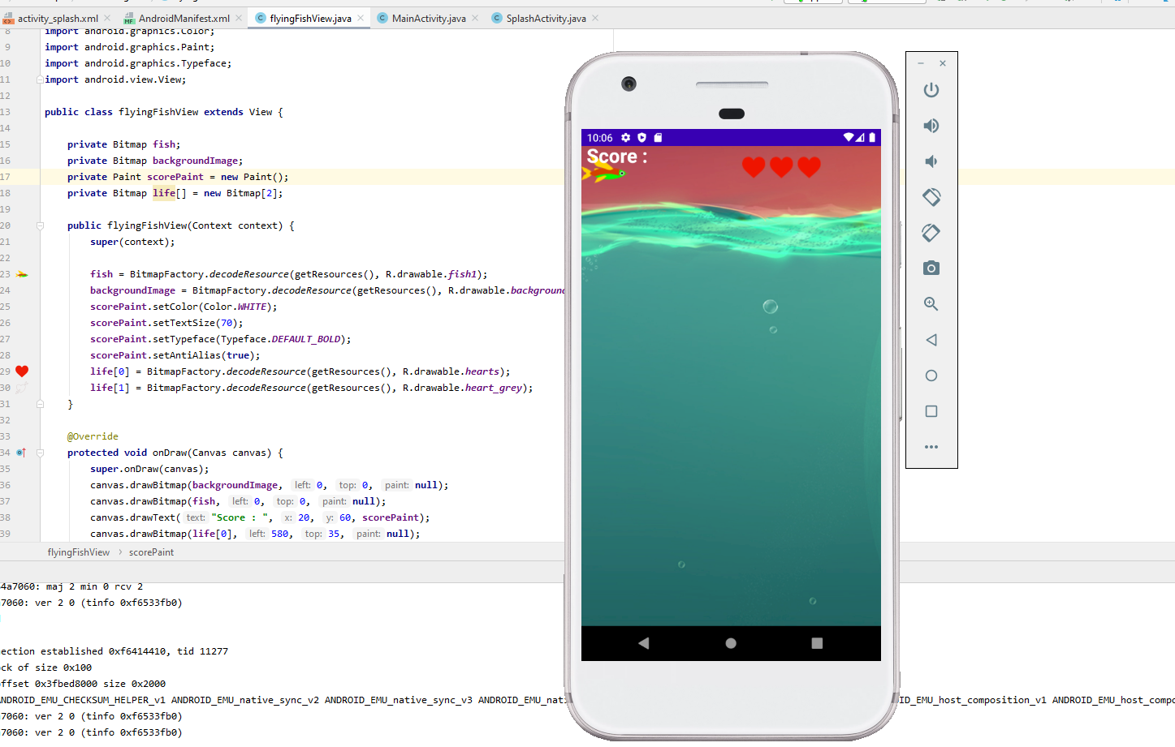
The main window of the game

Slide 7
Assignment
Create a timer of the splash screen holdup;
Put the background and the image of the fish on it;
Set the score and life’s icons.

